Slide 1
Choropleth Maps in R
Use of Choropleth Maps for Regional Statistics

Slide 2
What is a Choropleth Map?
These maps indicate the average values of a particular quantity in predefined areas
They use:
differences in shading
colouring
placing of symbols within predefined areas

Slide 3
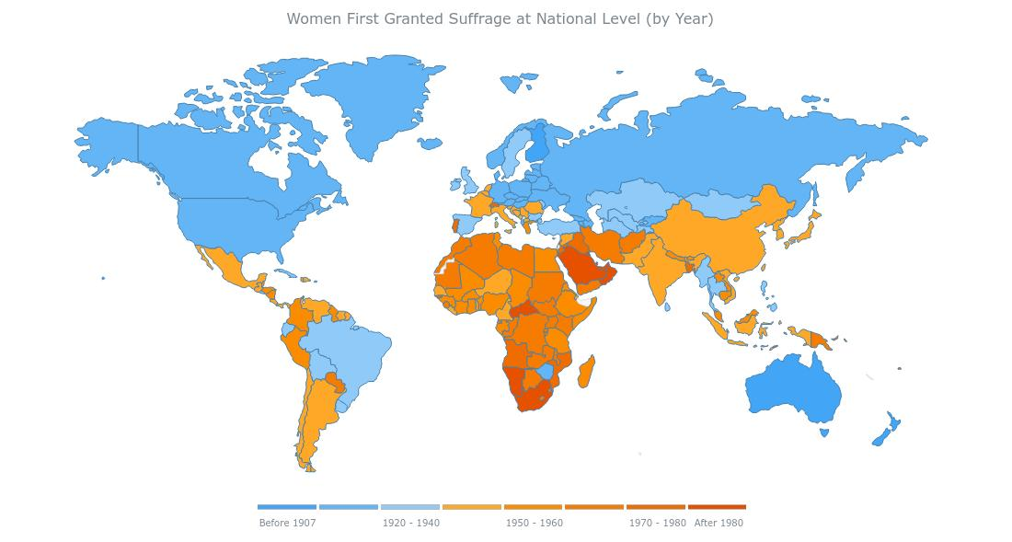

Slide 4
How to create these maps in r?
1) Download boundary files
2) Set up data
3) Write some R code
Packages used:
Sp
Rgdal
RColorBrewer

Slide 5
Boundary Files
Cartographic boundary shapefiles

Slide 6
What are cartographic boundary shapefiles?
Simplified representations of selected geographic areas
Shapefile format:
popular geospatial vector data format for geographic information system (GIS) software
developed and regulated by Esri
Environmental Systems Research Institute
supply ArcGIS software
(mostly) open specification for data interoperability among Esri and other GIS software products
The shapefile format can spatially describe vector features:
points
lines
polygons
Each item usually has attributes that describe it, such as name or temperature.

Slide 7
Resolution
Boundary shapefiles are available as Ungeneralised or Generalised
Ungeneralised:
Highest resolution data available
most detailed representation of actual boundaries
Generalised :
simplified, but preserve much of the original detail from the full dataset
typically 10% of the file size
Generalised are available in different resolutions:
20m
50m
100m
A Generalised (20M) boundary is within 20 metres of the Ungeneralised boundary.

Slide 8
Where to get the files?
Files updated after each census
2016 files available on census2016.geohive.ie
provides Census 2016 datasets combined with Ordnance Survey Ireland's boundary data
Look under “Explore Data via Census Themes”
Select Boundaries, choose which regional breakdown
Click Download, Shapefile

Slide 9
Regions in Ireland
Nomenclature of Territorial Units for Statistics (NUTS)
EU standard for territorial units
The Republic of Ireland consists of:
one NUTS-1 region
two NUTS-2 regions
eight NUTS-3 regions
Below this are 31 Local Administrative Unit 1(LAU-1) regions
generally correspond to the 26 counties
4 LAU-1 regions within Dublin
extra LAU-1 areas in regional cities

Slide 10
Regions in Ireland
Next territorial division is Local Administrative Unit 2 (LAU-2)
3,440 district electoral divisions (EDs)
EDs do not provide a homogeneous coverage of all areas in the country
Range from 76 individuals in some rural areas, to over 32,000 in Blanchardstown-Blakestown
Unevenness in population causes difficulties when mapping social and economic data
Small Areas (SA)
developed jointly by the Ordnance Survey of Ireland (OSI) and the Central Statistics Office (CSO)
for 2011 Small Area Population Statistics
18,641 Small Areas
much more homogeneous in their social composition
uniform population size with a mean of just under 100 households.

Slide 11
Shapefiles for Ireland
Provinces
Ireland is divided into four provinces:
Leinster
Ulster
Munster
Connacht
No administrative functions, but relevant for a number of historical, cultural and sporting reasons

Slide 12
Shapefiles for Ireland – 8 Nuts-3 regions
IE011 Border Region Cavan, Donegal, Leitrim, Louth, Monaghan, Sligo
IE013 West Region Mayo, Roscommon, Galway and Galway City
IE012 Midland Region Laois, Longford, Offaly, Westmeath
IE022 Mid-East Region Kildare, Meath, Wicklow
IE021 Dublin Region Dún Laoghaire–Rathdown, Fingal, South Dublin and
Dublin City
IE024 South-East Region Carlow, Kilkenny, South Tipperary, Wexford, Waterford City & County
IE025 South-West Region Kerry, Cork and Cork City
IE023 Mid-West Region Clare, North Tipperary, Limerick City & County

Slide 13
Shapefiles for Ireland
Administrative counties
31 administrative counties/cities
Electoral Divisions
3,440 Electoral Divisions
Small Areas
18,641 Small Areas

Slide 14
Other Shapefiles for Ireland
2013 Constituency boundaries
Municipal Districts
2014 Local Electoral Areas
Gaeltacht Areas
Na Limistéir Pleanála Teanga Ghaeltachta
Settlements (Census towns, cities and suburbs)

Slide 15
spatial data in R
Coordinate Reference Systems

Slide 16
Spatial Data
Spatial data represents actual locations on Earth
This requires
the coordinates of the object
a system of reference for how the coordinates relate to a physical location on Earth
Non-spherical shape of the Earth, which bulges at the equator, complicates the creation and use of a coordinate reference system (CRS)
Complex models have been created in attempts to accurately represent the Earth’s surface

Slide 17
coordinate reference systemS
Map projections:
use a geometric model to project a 3-dimensional ellipsoid onto a 2-dimensional plane
result in the distortion of aspects of the Earth’s surface such as area, direction, distance, and shape
use linear units of measurement such as meters instead of degrees
Coordinate Reference System (CRS):
using coordinates, defines how the projected map is related to real places on Earth

Slide 18
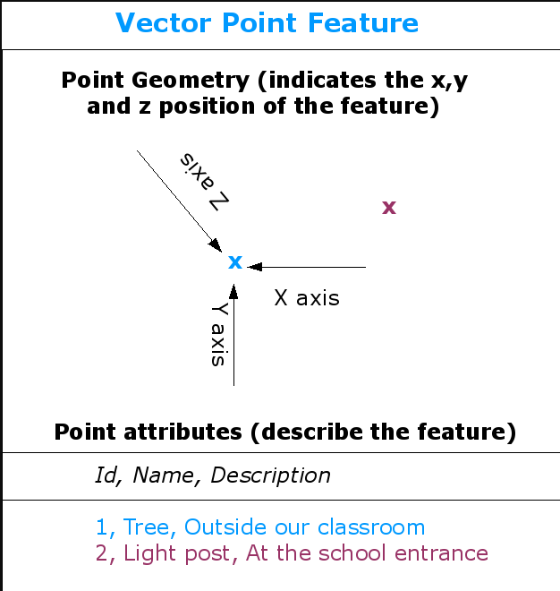


Points, Lines and Polygons

Slide 19
The sp package
First package to provide classes and methods for spatial data types in R
Development began in the early 2000s
Attempted to standardize how spatial data would be treated
Allow for better interoperability between different analysis packages that use spatial data
Provides classes and methods to create points, lines, polygons, and grids and to operate on them.
Many other spatial analysis packages use the spatial data types that are implemented in sp
E.g. rgdal package: use function readOGR()

Slide 20
Spatial Data
Standard R objects like data frames can’t properly represent spatial data
sp package defines its own classes of objects to store spatial data
The sp package uses S4 classes in R.
S4 objects are made up of slots that store different types of well-defined data.
Slots can be accessed with the @ symbol in the form of object@slot.
Foundational sp class is the Spatial class
ten subclasses differentiated by the slots they contain.

Slide 21
Import Shapefile into R
Spatial Polygons Data Frame

Slide 22
Import shapefile into r
Download file from census2016.geohive.ie
Downloaded files are zipped
Unzip to working directory
Import into R using the readOGR() function in the rgdal package like this:
localDir <- "Admin_Counties_Generalised_50m"
county_data <- readOGR(dsn=localDir, layer="Admin_Counties_Generalised_50m")
Notes:
Don’t include the .shp extension in the layer argument
localDir is a folder in the working directory

Slide 23
What’s in the file?
The imported file is a large SpatialPolygonsDataFrame
Slots:
Name: Class:
data data.frame
polygons list
plotOrder integer
bbox matrix
Proj4string CRS
Extends:
Class "SpatialPolygons", directly
Class "Spatial", by class "SpatialPolygons", distance 2

Slide 24
Spatial Polygons Data Frame
str(county_data, max.level = 2)
Formal class 'SpatialPolygonsDataFrame' [package "sp"] with 5 slots
..@ data :'data.frame': 31 obs. of 14 variables:
..@ polygons :List of 31
..@ plotOrder : int [1:31] 14 18 29 15 25 26 30 27 5 10 ...
..@ bbox : num [1:2, 1:2] -10.7 51.4 -6 55.4
.. ..- attr(*, "dimnames") = List of 2
..@ proj4string: Formal class 'CRS' [package "sp"] with 1 slot

Slide 25
Data Frame
One slot enables polygons to be associated with attribute data in a data frame
In our example, for a shapefile of counties, there are 31 observations.
These contain:
ID
name in English
name in Irish
x centroid
y centroid
province
shape area
shape length

Slide 26
Spatial PoLygons
Another slot contains a SpatialPolygons object
This contains several other objects, including an object of class “Polygon”
This contains several slots:
ringDir: Object of class "integer"; the ring direction of the ring coordinates, holes are expected to be anti-clockwise
labpt: Object of class "numeric"; an x, y coordinate pair forming the label point of the ring
area: Object of class "numeric"; the area of the ring
hole: Object of class "logical"; does the ring seem to be a hole
coords: Object of class "matrix"; coordinates of the polygon; first point should equal the last point

Slide 27
Data Setup
File Format

Slide 28
CSV file format
CSV file with column of region names – in this case county names
Second column with numeric values to be mapped
Values need to be standardised so they can be compared across regions e.g. percentages
Region names need to match exactly to ..@data$ENGLISH names in the SpatialPolygonsDataFrame
Or could use match on ..@data$OBJECTID
Sample File Extract:
County_name, nbr_ents_perc
DUBLIN CITY COUNCIL,9.06
DUN LAOGHAIRE-RATHDOWN COUNTY COUNCIL,9.06
MONAGHAN COUNTY COUNCIL,9.24
MEATH COUNTY COUNCIL,9.94
KILDARE COUNTY COUNCIL,10.10

Slide 29
R Code to Create the map
Sample R Code

Slide 30
Sample Code
## put number of counties into total variable
total <- length(county_data@data$OBJECTID)
# read in csv file with rates of enterprise tourism dependancy ratios by county into dataframe
tdr_df <- read.csv("ent_emp_tdr_31.csv")
## loop through 31 admin counties and match county name in county_data to county name in tdr_df file
order <- numeric(31)
for (i in 1:total){
order[i] <- match(county_data@data$ENGLISH[i], tdr_df$county_name)
}
Note: match will match the whole element. Used grep() previously and got error due to multiple matches (Meath / Westmeath)

Slide 31
Sample Code
## split nbr_ents_perc variable into 4 ranges
col_no1 <- as.factor ( as.numeric ( cut ( tdr_df$nbr_ents_perc [order], c(0, 10, 12.9, 14.9, 100) ) ) )
## Name the ranges - these names will be used as labels on the map
levels(col_no1) <- c("<10%", "10-12.9%", "13-14.9%", ">15%")
## add a column with the named ranges to the county_data dataframe
county_data$col_no1 <- col_no1
## choose 4 shades of blue
myPalette<-brewer.pal(4,"Blues")

Slide 32
Spplot()
Can’t use ggplot2 with spatial objects
Instead use base R plot system, or spplot() command
spplot ( county_data, "col_no1", col=grey(.9), col.regions=myPalette, main="Enterprise TDR by county“ )
Arguments to spplot():
object of class extending Spatial-class
character; attribute name(s) or column number(s) in attribute table
makes boundaries around regions light grey rather than default black
vector with fill colours; if the variable to be plotted is a factor, should have length equal to the number of factor levels
graph title

Slide 33
Output
Some examples

Slide 34
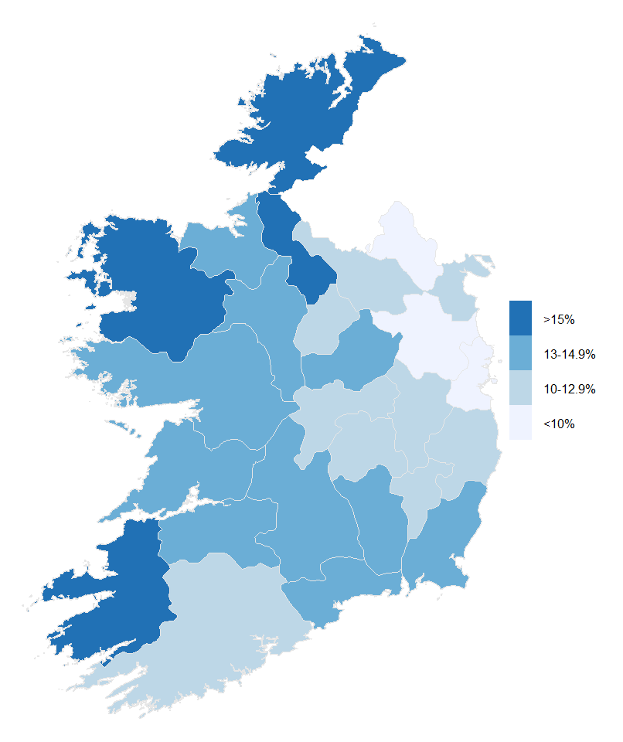
Choropleth map showing the Enterprise Tourism Dependency Ratio by County in the Republic of Ireland
Tourism Dependency Ratios (TDRs) are defined as the ratio of the Tourism Industries to the Total Economy for a particular region and variable.
Here, the Enterprise Tourism Dependency Ratio is the ratio, in each county, of the number of businesses in the tourism industries to the total number of businesses.
Tourism industries are activities that typically produce tourism characteristic products e.g. hotels, restaurants, passenger transport, travel agencies etc.
While these industries also provide services to non-tourists, they are a useful addition to measuring tourism, due to the difficulties in getting accurate information from the demand side of tourism, i.e. the tourists themselves.

Slide 35
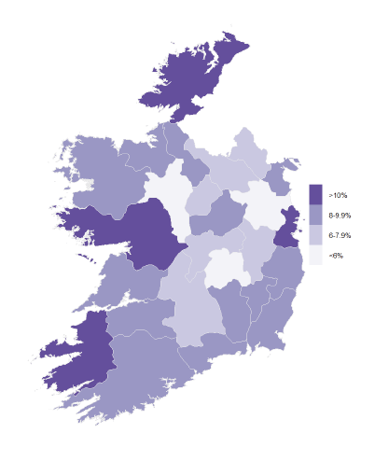
Choropleth map showing the Employment Tourism Dependency Ratio by County in the Republic of Ireland
Here, the Employment Tourism Dependency Ratio is the ratio, in each county, of the number of persons employed in businesses in the tourism industries to the total number of persons employed in that county.

Slide 36
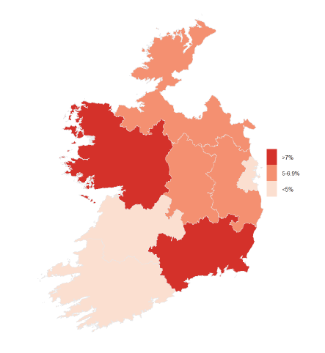
Choropleth map showing the Turnover Tourism Dependency Ratio by NUTS 3 region in the Republic of Ireland
Here, the Turnover Tourism Dependency Ratio is the ratio, in each county, of the turnover in businesses in the tourism industries to the total turnover in that region.

Slide 37
Small Area Estimation
More examples

Slide 38
Small Area Estimation
Small domains or small areas:
populations for which reliable statistics of interest cannot be produced due to data limitations
Generally, can produce unbiased estimates at detailed levels
But very large variance due to small sample sizes
Administrative data may be available at the required level of detail
Administrative data by itself can’t usually be used
Rarely measures exactly what we need
Can be used as a proxy
But often issues with this e.g. unemployment rates
However, admin data usually highly correlated with what we want to measure
Model data of interest using direct estimates from survey with admin data as predictors

Slide 39
Small Area Estimation of unemployment
Produce estimates of unemployment rate at regional level
Sample size in counties / electoral districts / gender / age groups too small for precise estimates
Combine Labour Force Survey data with administrative data on unemployment benefits
Model unemployment proportion using claimant proportion and other demographic variables as predictors
Gender
Age Group
Educational attainment
Etc.

Slide 40
U.S. Census Bureau's SAIPE program
Small Area Income and Poverty Estimates (SAIPE) program
annual estimates of income and poverty statistics for all school districts, counties, and states
used in the administration of federal programs and the allocation of federal funds to local jurisdictions
used by state and local programs for distributing funds and managing programs
County and state estimates:
total number of people in poverty
number of children under age 5 in poverty (for states only)
number of related children ages 5 to 17 in families in poverty
number of children under age 18 in poverty
median household income
School districts estimates:
total population
number of children ages 5 to 17
number of related children ages 5 to 17 in families in poverty

Slide 41
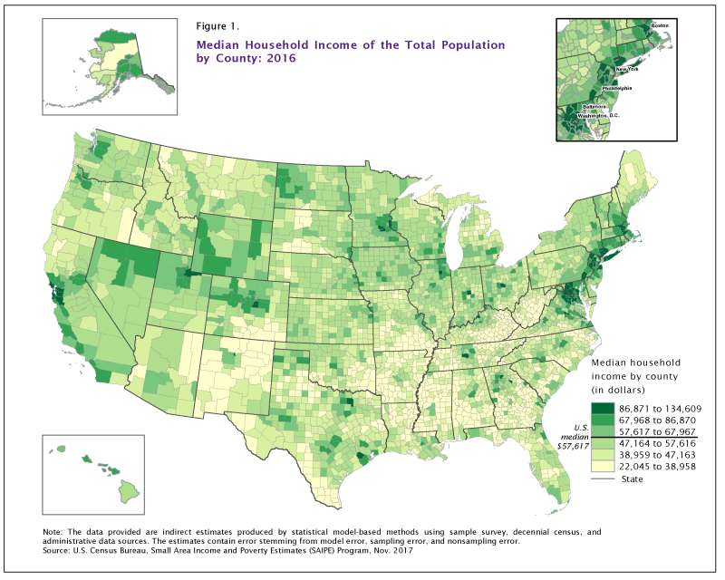

Slide 42
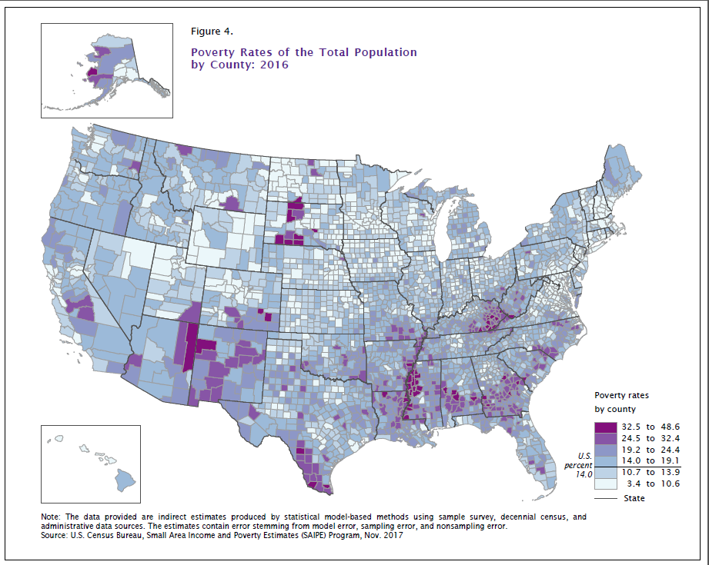

Slide 43
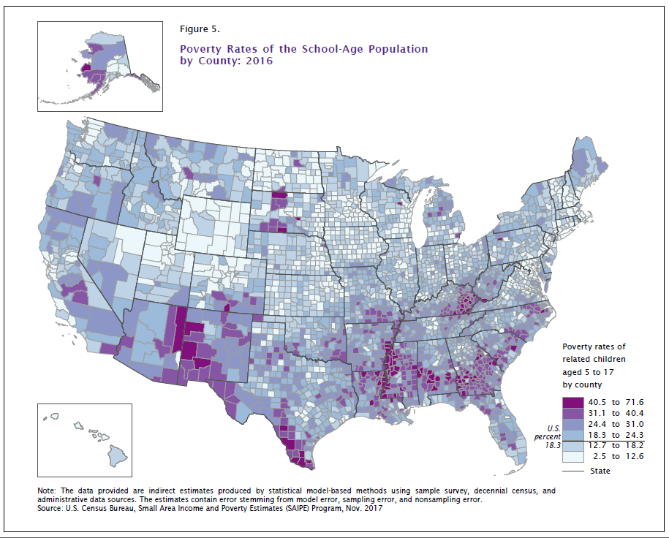

Slide 44
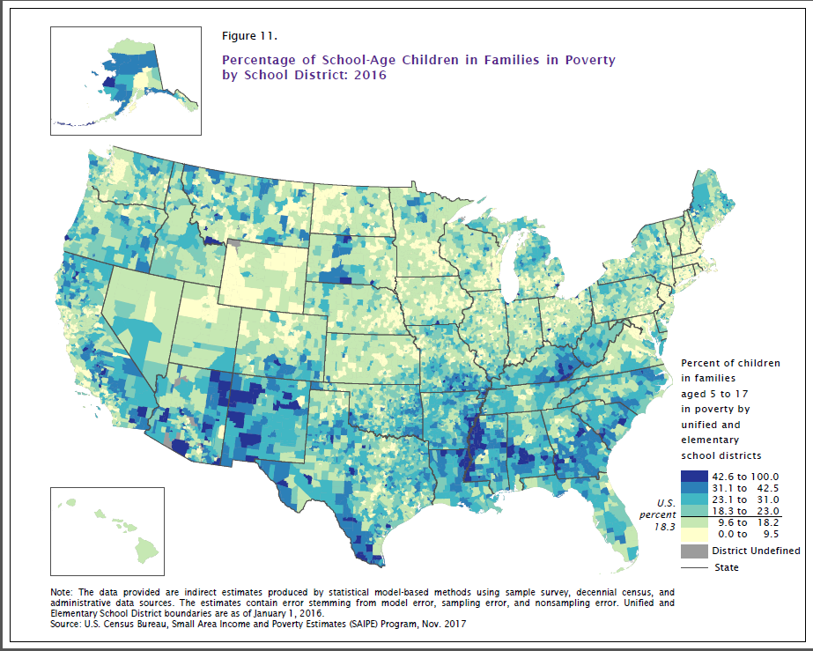

Slide 45
Conclusion
Choropleth maps are a nice way of displaying geographic data
Spatial statistics can be extremely complicated
But to create a choropleth map you only need:
Boundary file
Data file
Few lines of code
Questions?
Jillian.Delaney@cso.ie

